Slide 1
Implementing evidence-based practice for child neglect
Daniel J. Whitaker, PhD
Shannon Self-Brown, Ph.D.
Georgia State University
National SafeCare Training and Research Center

Slide 2
Today’s Presentation
Neglect basics
Interventions for neglect
  Partner violence
Implementation issues

Slide 3
What is Neglect?
What are minimum requirements for parenting?
Must the action or inaction be intentional?
What is the role of poverty?
How does child development play a role?
What are one-time behaviors that are considered neglect vs. behaviors that must be chronic to constitute neglect?
What is the role of culture and religion?
Notes:
Very hard to define as it involves deficiency of behavior
Few theories for neglect have been proposed
Thus, clinicians, states, and researchers have struggled with best way to define neglect

Slide 4
www.npr.org
3/2/10 report, Pam Fessler
“Further complicating matters is that there is
no federal definition for what is or isn't abuse
and neglect. Something that might be
considered a child abuse or neglect case in
one state might not be considered one in
another.
Take the case of a toddler who gets outside
his or her house and is hit by a car. Was it an
accident or neglect?”

Slide 5
CDC Uniform Definitions
Neglect—Acts of Omission
  Failure to provide
    Physical
    Emotional
    Medical
    Educational
  Failure to supervise
    Inadequate supervision
    Exposure to violent environments
Notes:
Physical-abandonement, shuttling, nutritional; (nutrition, hygiene, shelter, clothing)
Emotional-inadequate nurturing or affection, chronic or extreme domestic violence, permitted drug use of maladaptive behavior, isolation
Educaiton-permitted truancy, faiure to enroll, refusal or inattention to special ed
Medical-denial of helath care, note: due to CAPTA no federal requirement for a parent to provide any medical treatment if it is against parents reliogous beliefs. Delay of health care

Slide 6
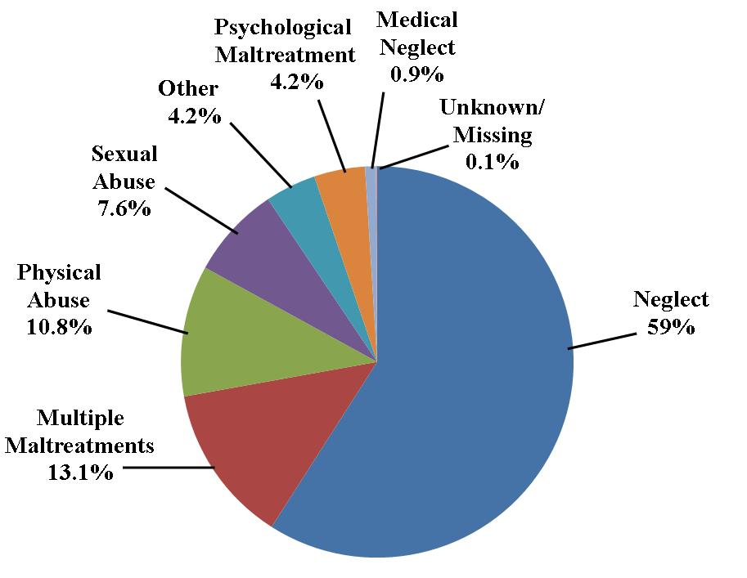
Prevalence of Maltreatment Types: CPS
Types of Abuse
3.2 million reports abuse/neglect.
794,000 children substantiated.
59% were neglect, 72.1% if consider multiple maltreatments
Past findings suggest caseworkers less likely to substantiate neglect referrals

Slide 7
Neglect Prevalence by Age and Race
In terms of neglect, 61.2% of substantiated cases was for children under age 7.
Disproportional according to race:
  Of the victims of all maltreatments, 45.4 percent were White, but only 36.4 percent of medical neglect victims were White.
  African-Americans comprised 21.4 percent of all victims, but 35.3 percent of medical neglect victims

Slide 8
National Incidence Study of Child Abuse and Neglect-4
CPS data + reports from sentinel agencies
Collect data in 122 counties
Categorize harmed vs. endangered children
Abuse
  physical, sexual, emotional
Neglect
  physical, emotional, educational
Notes:
Harm-nature of maltreatment result in demonstrable harm very stringent
Endangered-child not yet harmed but endangered by caregiver behavior

Slide 9
Prevalence of maltreatment types: NIS
NIS-4 (harm)
1.25 million children experienced abuse during study year (2005-2006)
1 in 58 children
Maltreatment types:
  44% abused
  51% neglected
Maltreatment type | Rate per thousand
Physical abuse | 4.4
Sexual abuse | 1.8
Neglect | 10.5
Notes:
Using stringent harm data, not endangered
47%educational, 38% physical, 25% emotnional
FYI, with looser endangerment definition 3 million children experienced maltreatment, 1 in every 25 children, with 77% experiencing a type of neglect

Slide 10
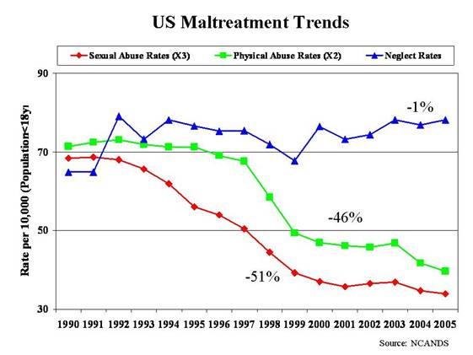
Maltreatment Trends
Maltreatment type | NIS-3 (1993) to NIS-4 change (2005-06)
Physical abuse | 23% decrease
Sexual abuse | 44% decrease
Emotional abuse | 33% decrease
Neglect | No change
Notes:
3 decades of efforts to improve economic status have no resulted in preventing neglect, thus cant be associated with poverty alone

Slide 11
Maltreatment Trends
Overall, NIS-4 reported a 26% decline in child maltreatment per 100 children since 1993
NCANDS data indicates significant decreases in CPA and CSA over last 15 years
Both data sources indicate very little change in neglect
Why?
  Is neglect harder to prevent?
  Is neglect not subject to other social changes that do impact CSA and CPA?
  Or has our field neglected neglect?
Notes:
Why questions..
yes, but Not holding- the programs started in the 80s and rate decline not seen until 90s
Increasing criminal justice involvement in childmaltreatment (applies more to CSA and CAP). Doesn’t hold because sexual abuse has 45% crime and physical abuse is 28% yet both declines
3. Economic improvement
Criminal justice interventions
Child welfare improvement
Widespread psychiatric medication
Generational change and new attitudes

Slide 12
“Neglect of Neglect”
Child Protection Systems
  CPS focuses on recent, distinct, verifiable incidents
Program
  Few prevention programs have been developed to directly target neglect
Law enforcement
  focused on maltreatment that can be can be prosecuted
Research 1990s
  Less than 2% of federally funded child maltreatment research targeted neglect
  There were no published reviews on effects of neglect
Notes:
Researchers have focused on CPA/CSA because definitions and theoretical models were more available

Slide 13
“Neglect of Neglect”
All the while, neglect is and historically has been the dominant problem faced by child welfare systems
Neglect has been referred to as “Poor cousin of child maltreatment research.”
Some have described the lack of focus on neglect as “making a mole-hill out of a mountain”
Notes:
However, within child welfare the reality of child maltreatment is much different

Slide 14
Positive Trends in Neglect Field
Positive trends in research:
  Definitions and theoretical models are progressing
  Proportion of studies on physical abuse and neglect have increased relative to number focused on sexual abuse
  Overall number of funded projects for all types of maltreatment has increased
Positive clinical trends:
  Evidence-based practices for prevention of neglect are being actively disseminated

Slide 15
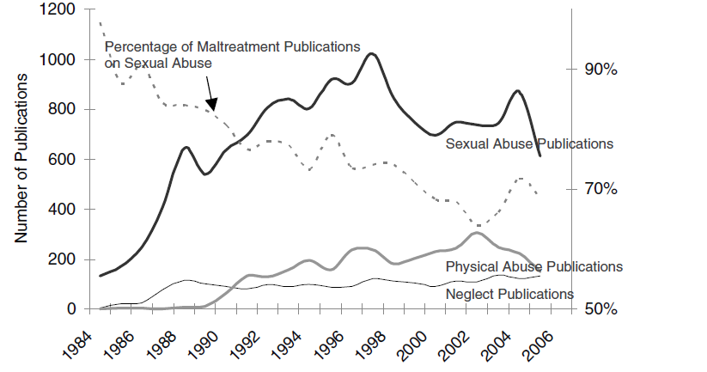
CM Publications

Slide 16
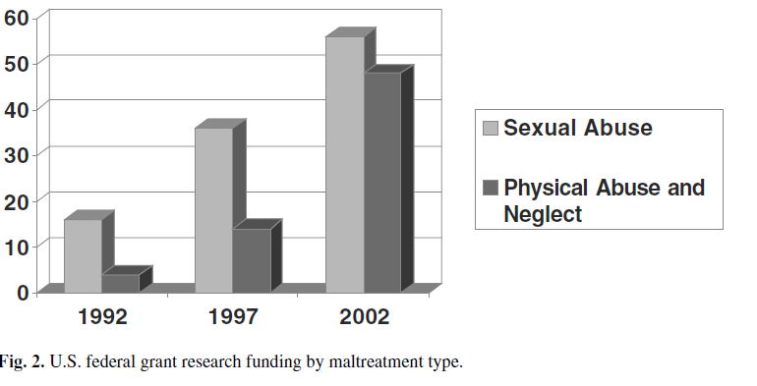
CM Federal Funding

Slide 17
What Predicts Child Neglect?
Resources:
  Depanfilis, 2006
  Schumacher, Slep, & Heyman, 2001
  Connell-Carrick, 2003
Theoretical/Etiological models
  No widely accepted models
  Recent focus on social-ecological theory
Notes:
Social ecological –parent behavior occurs in conjuction with community and societal factors to result in neglect
That is why neglect is most chronic form of abuse
Most neglect is rooted in social factors that are difficult to change
Child welfare neglect cases are typically from the poorest and most marginalized social groups

Slide 18
Community Factors
Neglect is more prominent in communities with:
  Poverty
  School Dropout
  Violence
  Single parent home
  Low social support
  Urban areas
  Accessibility of health care
Notes:
Study included in this review examined 195 zip codes in Missouri with 1000 families
18 X’s the amount of neglect in communities with greater poverty as compared to communities with highest poverty
Sedlak found children living in urban counties at highest risk for physical neglect and educational neglect

Slide 19
Family Factors
Home environment
  Poverty/low income
  More individuals in the home
  Single parents
  In two-parent homes, higher parent conflict
Family Functioning
  High chaos
  High levels of family stress
  Less expressive of positive affect/emotions
  Less empathy/warmth
  Less cohesion
  Religion
Notes:
Again, across studies, poverty increased risk for neglect from 20 to 162 x’s in families less than 15K
Combinations also increase risk, like low income and single parent or high poverty and young maternal age. Those young (17 and under)and impoverished were 17x’s those 22 and impoverished.
There seems to be something significant about having 4 or more children that doubles and triple rates of neglect
Considering community and family factors, highlights that child neglect is associated with disparity because overrepresented among poor

Slide 20
Community and Family Factors, NIS-4
Unemployment/not in labor force = 2.7- 4 times the risk
Low SES = 4-8 times greater risk
Single parent = 12 times greater risk
Homes with 4 or more children = 2 times greater risk
Rural counties = 2 times greater risk compared to major urban and urban

Slide 21
Poverty and neglect
Majority of low-income families do not neglect
Middle-class and low-income parents share many common definitions for neglect
Slack examined parent behaviors in relation to 5 poverty variables
Only 1 poverty variable predicted neglect
Significant predictors:
  Parent Perceived Financial Hardship
  Young child
  Parent with a learning disability
  Cohabitating
  Parent child interaction, corporal punishment, and parental warmth
Notes:
Poverty=household income, proportion of months with temporary assistance, proportion of quarters with earnings, material hardship, perceived hardship scale
This supports ecological transactional model

Slide 22
Parent Factors
Demographics of Caregivers
  Young parent age
  More often female
Parent Characteristics
  Unemployment/Underemployment
  Lower education
  Fewer parenting skills
  Lower social support
  History of maltreatment and IPV
Notes:
Age 17 and under at highes risk
Findings related to race are mixed, some have found non-whit and others have found white to be more at risk
Gender association likely tied to the fact that females are primary caregivers, NIS-4 Majority of neglected had female perps (86%)
Parenting skills=less knowledge of child development, poor problem solving skills. i.e. thinking a 4 year old can be left alone for an evening; inconsitent or harsh discipline
Neglecting mothers over 3 times history of sex abuse, and are more likely to experience abuse as adults
Another study found that Integenerational transmision-between 25-35%
One study found that in 35% of neglect case, IPV had also occurred in the home

Slide 23
Parent Factors (cont.)
Parent Mental Health
  Lower self-esteem
  Higher impulsivity
  Depression/Substance abuse diagnosis
  Lack of social support
  Higher levels of daily stress
Behavior of Caregivers
  More verbal aggression/lower verbal accessibility
  Lower positive behavior/ more negative behavior
Notes:
Lower self-esteem, less confident, less outgoing, poor social skills
Neglectful mothers view themselves as less supported
Several studies have found mother more likely to be depressed,
Post partum depression, place at risk to be less responsive and sensitive to infant and infant may be disengaged or withdrawn
However, substance abuse may moderate (chaffin, 1996)
Mental health according to NIS
For majority all 3 types of neglect, alcohol, drug, and mental illness increased risk. However for each type, substance use was significantly greater risk factor
Behaviors studies mostly conducted in laboratory task observations, with threats to ecological validity. Clear that neglectful mother interact less positive with children than do controls and that verbal and non-verbal behaviors quite different

Slide 24
Child Factors
Age
  Some research suggest no main effect for age, while other research suggests children < 3 are at greatest risk
  CPS data suggest children < 7 at greatest risk
  Emotional and education neglect increase with age; physical neglect decreases with age
Gender
  NIS-4 suggests boys may be at greater risk for neglect
Behavioral Problems/Disabilities
  Research suggests that mother’s perception of child behavioral problems/temperament impacts neglect
  Several studies indicated that children with disabilities are at greater risk for neglect

Slide 25
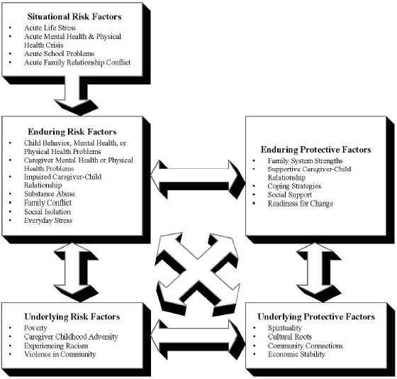
Model of Child Neglect¹⁰³

Slide 26
Neglect VS CPA/CSA
Risk factors are similar for CPA and neglect, but not CSA
  Perpetrators are usually primary caregivers
  More often women than men
CPA and neglect tend to co-occur
Child welfare service involving CPA without neglect are rare
  CSA abuse victims are at higher risk for other maltreatment than non-victims, but comorbidity far lower than for CPA and neglect
Response to neglect is different than CSA and CPA
Notes:
Separate perpetrator and victim vs rehabilitate

Slide 27
How doe we distinguish neglect and CPA?
Most CPA occurs in a context of discipline
CPA is characterized by factors associated with corporal punishment and parent-child interaction
Neglect is rooted in social disadvantage, substance abuse, isolation, and child care burden,
Neglect cases are the ones most likely to be handled entirely by CPS with no criminal justice component

Slide 28
How do we distinguish neglect and CPA?
Meta-analysis of 33 studies comparing parent-child interactions among parents with and without a history of CPA or neglect
Results suggested distinct interaction patterns
  Negative affect distinguished CPA parents from non-maltreatment parents
  Involvement, responsiveness, cooperation, and interest, better distinguished neglectful parents from non-maltreating parents
  Positive behaviors, positive affect, approval and support, were equally useful in determining both types of maltreatment from non-maltreating parents
Notes:
Aversive behaviors and parental actions that communicate

Slide 29
Outcomes Associated with Neglect
Prior to 1993, there were no published reviews on effects of child neglect
Crouch (1993) published a review documenting the impact of neglect on:
  Nonorganic failure to thrive
  Intellectual development
  School performance
  Social isolation
  Poor adult outcomes, including delinquency, adult criminality, and violent behavior
Notes:
While many maltreated children cope reasonably well with adversity and have no long lasting mental health problems
research evidenced that mother of NOFTT babies had less adaptive social interaction, less positive affect with infants

Slide 30
Impact of Neglect
Neglect outcomes vary considerably in type and expression.
Importantly, many of these outcome do not fit into mental health diagnostic systems.
  Impaired brain development
  Physical Health
  Behavioral problems
  Intellectual and cognitive development
  Poor attachment
  Social and emotional withdrawal
  In adulthood, violent and criminal behavior
Notes:
Associated with failure of brain to form properly which can impair physical mental and emotional development
Neglected children most likely to have highest proportion of mental retardation
Those that experience global neglect have smaller brains than the norm
Health—premature birth, injuries due to improper supervision, failure to thrive, dehydration , asthma
Cognitive deficits, lower iq and reading ability, more sever language disorders, academic difficulties
Emotional neglect extremely detrimental during infancy, show major declines on scales of infant development and poor attachment

Slide 31
Outcomes Specific to Adolescence
In National Longitudinal Study of Adolescent Health, adolescents were asked about childhood experiences and current health/mental health
Teens who reported a history of supervisory or physical neglect were at greater risk than non neglected adolescent to:
  Have poor health
  Be depressed
  Have cigarette, alcohol, and marijuana use
  Violent behavior
Notes:
Hussey et al

Slide 32
Outcomes According to
Neglect Type
Reviews to date often lump various forms of neglect in one category
May be important differences in outcomes according to neglect types
May be a need for specific interventions according to type

Slide 33
Neglectful Behaviors | Consequences
Inadequate food | Impaired mental development, Internalizing behavior problems, Diminished birth weight, Failure to thrive
Exposure to hazards | House fires, Access to firearms, Fall from heights, Toxic exposures
Inadequate personal hygiene | Adverse health outcomes, Obesity
Inadequate health care | Serious injuries not treated, Several health problems not identified or treated, Untreated dental problems, Death
Inadequate mental health care | Suicide, Delinquency, Poor school achievement, Psychiatric symptoms
Inadequate emotional support | Externalizing problems, High-risk behavior, Poor academic performance
Inadequate parental structure and/or guidance | Sexual risk taking, health risk behavior (e.g., sexual behavior, substance and/or drug use, drug trafficking, school truancy, and violent behaviors
Inadequate cognitive/ stimulation/opportunity | Delayed motor/social development, lower language competence, externalizing problems, aggression, delayed socioemotional and cognitive development
Unstable caregiver relationship | Insecure attachment, Externalizing behavior, Internalizing behavior
Unstable living situation | Externalizing behavior, Internalizing behavior, Anxiety
Exposure to family conflict and/or violence | Poor physical health, Lower health status, Internalizing and externalizing behavior, Post-traumatic stress disorder
Exposure to community violence/lack of neighborhood safety | Behavior problems, Poor school attendance and behavior problems, Distress, Behavior problems, Social maladjustment

Slide 34
Outcomes as compared to CPA
Neglect is distinguishable from CPA in terms of:
  cognitive and academic deficits,
  expressive and receptive language
  social withdrawal,
  limited peer acceptance and
  internalizing problems
Neglected children more aggressive than non-abused but less aggressive than physically abused.
Notes:
Two longitudinal projects indicate that neglected children experience signficant internalizing problem and may have more emotional problems than physically abused children, but fewer externalizing problems than CPA

Slide 35
Outcomes as compared to CPA
Neglect is distinguishable from CPA in terms of:
  cognitive and academic deficits,
  expressive and receptive language
  social withdrawal,
  limited peer acceptance and
  internalizing problems
Neglected children more aggressive than nonabused but less aggressive than physically abused.
Notes:
Two longitudinal projects indicate that neglected children experience signficant internalizing problem and may have more emotional problems than physically abused children, but fewer externalizing problems than CPA

Slide 36
Part II: Neglect interventions
State of neglect interventions
Popular interventions for neglect
Issues for consideration
Addressing partner violence
Notes:
For the next 30 minutes or so, I’ll be talking about various things related to interventions for neglect.
The field is a bit disjointed around neglect interventions, so I thought I’d try to organize my thoughts in this way.
First, I’ll give a broad overview of neglect interventions. Then I’ll describe a few of the popular interventions that are available
Next I’ll talk broad about some broad considerations for neglect interventions
Finally, I’m going to end with some comments about partner violence; this is an area of interest for me and an issue strongly related to child maltreatment.

Slide 37
Intervention premises
Nothing will work for all families
Something will work for most families
But those thing may be very different
  Duration
  Intensity
  Chronicity

Slide 38
EB interventions for CM
Parent training
PCIT (1)
Incredible Years (1)
Triple P (1)
1-2-3 magic
ABC
Nurturing parenting
Parenting Wisely
SafeCare
STEP
Teaching family model
Neglect
HomeBuilders (2)
Childhaven (2)
SafeCare (3)
Family Connections (3)
Notes:
Here I’ve listed out some of the EB programs in various topic areas as listed at the CEBC web site
If you’ve been on the CEBC web site, you know they list programs by content area

Slide 39
Parent training interventions
Most:
  Use cognitive-behavioral strategies
  Teach positive behavior management strategies and non-coercive discipline
  Some teach engagement, nurturing, promoting of attachments
Strategies are most effective for physical abuse and psychological neglect
Do not address physical, medical, educational neglect

Slide 40
Principles for neglect intervention (Gaudin)
Ecological and developmental framework
Comprehensive family assessment
Utilization of community resources
Good working alliance
Empowerment and family strengths
Cultural competence
Developmental appropriateness
Notes:
Ecological and developmental framework
Comprehensive family assessment
Utilization of community resources
Good working alliance
Empowerment and family strengths
Cultural competence
Developmental appropriateness

Slide 41
Family Connections
DePanfilis and Dubowitz
Ecological model
In-home, family-centered
Operates in Baltimore MD
FC replication project
  8 sites

Slide 42
Family Connections
Four core components
Emergency Assistance
Home-based intervention
Service coordination
Multi-family recreational activities

Slide 43
Family Connections
Nine Service Principles
Community outreach
Individualized family assessments
Tailored interventions
Helping alliance
Empowerment approach
Strengths perspective
Cultural competence
Developmental appropriateness
Outcome driven service plans

Slide 44
Family Connections
RCT comparing 3- vs. 9-month program
Messy design; no comparison
Improvements from pre to 6m post
  Depression, parenting attitudes, competence, stress, social support
  No difference between 3m vs. 9m
8 site replication in progress

Slide 45
HomeBuilders
Founded in WA State
Goal: prevent removal or promote reunification
Brief intervention period (6 weeks)
Intensive
  24 hour availability
  10-12 hours per week
Low caseloads

Slide 46
HomeBuilders
Three main focal points of tx
  Relationship building, motivation, setting treatment goals
  Skill building
  Concrete assistance

Slide 47
Homebuilders data
Fraser et al (1996), Homebuilders vs. SAU
HB: more and faster reunification at 3m
At 15m, 70% of HB kids were in home vs. 47% of SAU kids
At 6 years, no difference in child welfare contact (Walton 1988), but HB cheaper

Slide 48
SafeCare
Lutzker, Project 12-Ways
California, Oklahoma, Georgia
Behavioral, skill-based approach
For parents of children ages 0-5
Three modules
  Health
  SafeCare
  Parent-child interactions

Slide 49
SafeCare
18-20 sessions, ~90 minutes
5-6 sessions per module
Structured teaching model
Structured problem solving
Assess
Train
Assess
Explain
Model
Practice
Feedback

Slide 50
SafeCare data
Many single-case studies
Comparison group studies
  SafeCare CA: SC reduced CM by 75%
Oklahoma trials
  Prevention trial
    Positive parental report outcomes
  Statewide trial
    Family outcomes
    provider outcomes

Slide 51
Comparison
HB, FC, and SC differ in many ways
  Intensity
  When it’s appropriate
  Structure
  Tailoring
  Kitchen sinkness
  Social workiness
These 3 interventions may actually be for different populations

Slide 52
Intervention considerations
Social ecological model: Useful to a point
Notes:
Social ecological perspective is useful to a point. What I mean by that is if you start looking at S-E models, they include everything as potential risk factors. From individual level characteristics to very broad social level determinants. This is probably most useful if your goal is to account for a lot of variance in a statistical model. But if your goal is to intervene, you’ve got to know where to start, and where to stop. You’ve got to know

Slide 53
Intervention considerations
Poverty is highly related to neglect
Neglect rate among low income is 46/1000
But non-neglect rate is 954/1000
Poverty is a problem, but certainly not the whole story
Paxson and Wadfogel (2003)

Slide 54
Intervention Considerations
Is more better?
  Not always; Kaminski et al review
  Attrition vs. self selection?
  Shorter duration = greater reach
How to deal with “frequent flyers”?
  We use an acute care model for all
How do we think about dealing with different kinds of neglect cases?
We don’t have good assessments

Slide 55
Chronic neglect cases
Some families have multiple and recurrent referrals
  Large % of cases
  Use high % of all resources
How do they respond to services?
Are there distinct patterns of service response?
Notes:
Multiple and recurrent referrals (often 4 or more, and up to 20-40)
Comprise a large portion of child welfare service cases
Absorb a sizeable portion of all service resources
Unclear what their service response might be and how SafeCare of any other service program might best serve these cases

Slide 56
Service response trajectories
OK statewide data (N ~ 2100)
Goal: to describe service response patterns
  What patterns are associated with chronicity?
  What patterns are associated with recidivism?

Slide 57
Methods
Create overall risk measure (latent class analysis)
  Depression, child abuse potential, substance use, family resources, etc
Examine changes in this risk measure over time
  Before tx; After tx; 6m follow up
Look at response to services
Understand whether response patterns are related to chronicity of CM reports

Slide 58
Service Response Trajectories
Risk
Notes:
Great past referrals are more likely to be in 2 problematic response classes, 4 & 5.
Initially high problems, no response
Initially high problems, positive response, but relapse after services have ended
Both trajectories are also related to greater future referrals.

Slide 59
Do we need a range of service responses?
We give most everyone an episodic, acute-case services
Some families may need a ‘maintenance’ model
Others may need “boosters”

Slide 60
What about partner violence?

Slide 61
Partner violence and child maltreatment
Why consider them together?
Large overlap between IPV and CM
Detrimental effects of IPV
Partner violence can attenuate the impact of other programs
Common risk factors for CM and IPV
Notes:
Partner violence can attenuate the impact of other programs
Eckenrode et al (2000, JAMA) found that as partner violence increased, the positive effects of NFP on maltreatment decreased
Duggan (2004) and others: HV can’t identify IPV and are unsure what to do about it if they do identify.
There are common risk factors for CM and IPV
Smith-Slep & O’Leary (2005) review common & unique risk factors
Anger, verbal aggression, blaming attributions, emotional dysregulation, economic strain, social isolation, substance use/abuse, aggression in family of origin
Capaldi’s developmental dynamic model
Couples dysfunctional interactions are caused by same processes as dysfunctional parent-child interactions

Slide 62
What works in IPV prevention?
Short answer: Not a lot
Where has most research been conducted?
Primary
Secondary
Tertiary
GAP
Notes:
What might be appropriate for high risk young adults?
YRP – done with teens whose parents were CPS involved
Within My Reach
Group-based program for at-risk single mothers.
Based on PREP – well studied couples counseling program

Slide 63
What do most home-based programs do about IPV?
Refer & Support; maybe safety planning
Duggan (2004), Most providers don’t know what to do
Most families don’t get assessed (Hazen 2007)
Wash State uses 1 question (English 09)
No curricula for in-home intervention

Slide 64
What should an home-based IPV intervention include?
“There is nothing so practical as a good theory”, Kurt Lewin (1951)
Controversy: Feminist vs. conflict
IPV is not a unitary construct
  Different forms of violence
  Different motives and precipitants
  One explanation = too simple
  Terroristic and situational violence
  Likely a need for multiple interventions

Slide 65
What does IPV in child welfare populations look like?
English, Silovksy, Windham, Hazen etc.
Partner violence rates are high (40%)
Most IPV is:
  Conflict-related & low level (English)
  Bi-directional, both partners perpetrate (all)
  Includes psychological abuse
Conflictual interactions are general

Slide 66
Other relevant points to consider
Bidirectional IPV = higher likelihood of injury
Bidirectional IPV = very consequential to child outcomes
  English et al (2009); Windham et al. (2004)
Partner violence is often related to generalized aggression
Family conflict patterns predict partner violence
Assortative partnering
  Violence-prone individuals tend to find each other
Notes:
Bidirectional IPV = very consequential to child outcomes
English et al (2009) found that women’s perpetration (and bidirectional) related to greater problem behaviors among children than men’s alone
Windham et al., (2004) reported serious bidirectional partner violence predicted physical abuse compared to male only
Partner violence is often related to generalized aggression
Strongest developmental predictor of the onset of partner violence is prior antisocial behavior (data from 5 longitudinal studies)
Women in this sample have multiple conflictual relationships

Slide 67
Putting it together
Providers with few tools to assess or intervene
Lots of conflict between family members and others
Poor conflict resolution skills
Conflict may escalate
Few positive interaction skills

Slide 68
Possible intervention points
Relationship skills training
  Active listening
  Assertive communications
  Time outs
  How to talk about problems
  Problem solving
Thorough assessment needed

Slide 69
Part III: Dissemination and implementation issues
What is dissemination?
  targeted distribution of info to specific audiences
What is implementation?
  Adoption and integration of EBP into existing service systems

Slide 70
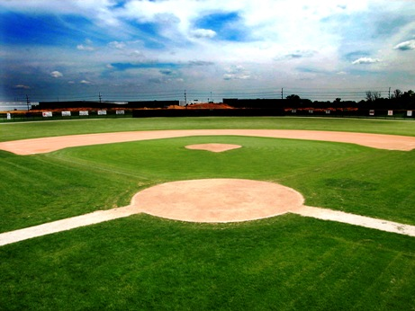
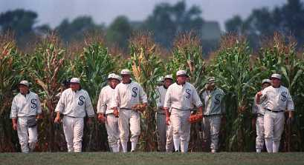
Dissemination models
If we build it model…
If we build it…
They will come…

Slide 71
What really happens… We build it, and…
They don’t like it

Slide 72
What really happens… We build it, and…
They think they already have it

Slide 73
What really happens… We build it, and…
They want to come, but their bosses won’t let them

Slide 74
What really happens… We build it, and…
They can’t afford a ticket

Slide 75
What really happens… We build it, and…
They can’t find the stadium

Slide 76
What really happens… We build it, and…
They’ll come, get it, but then rebuild it

Slide 77
What really happens… We build it, and…
They LOVE it and want 100 more, RIGHT NOW!!

Slide 78
The Lesson
We have to think about how we disseminate programs
If you are buyer, pay attention to dissemination and implementation methods

Slide 79
Program Implementation
What is implementation?
  “A set of activities designed to put a program of known dimension into practice” (Fixsen et al 2005)
Or, ”Doing what you set out to do”
  Known dimension
  A set of activities
  There is a process to attend to regarding those activities

Slide 80
Most common implementation model…
Train
&
Hope

Slide 81

What’s important in implementation?
From, Fixsen and colleagues
http://www.fpg.unc.edu/~nirn/

Slide 82
Implementation processes
Implementing a practice is a process
  Exploration/adoption
  Program installation
  Initial implementation
  Full operation
  Innovation
  Sustainability

Slide 83
Core components

Slide 84
Why care about implementation?
“Children cannot benefit from an intervention they don’t experience” (Karen Blasé, 2009)
Implementation relates to outcomes
  Durlak & DuPre (2008)
Effect sizes diminish with disseminated
  MST ES in efficacy studies = .81
  MST ES in effectiveness studies = .26

Slide 85
SafeCare implementation model
Balance of rigor and efficiency
Disseminating expertise
Major phases
  Readiness
  Initial training
  Implementation support
  Sustainability

Slide 86
Phase 1: Readiness
Readiness exists at different levels
  People
  Organizations (structures & processes)
  Systems
Readiness is highly context dependent
  What needs to be addressed at Site A may not apply at Site B

Slide 87
Phase 1: How we get ready
Series of cascading phone calls
SafeCare application
More conversations
Site visit with meeting
  Trainees + management + funder
If readiness is low, implementation will fail

Slide 88
Readiness Fail
“I’m an intake worker, and don’t really work directly with families”

Slide 89
Readiness Fail
“Cindy couldn’t make it so she sent me instead”

Slide 90
Readiness Fail
“I have to do all THAT?!?”

Slide 91
Readiness Fail
“My families are going to hate this.”
“My families will never agree to let me look in their cabinets.”
“My families will never agree to be recorded”

Slide 92
Readiness Fail
“Forget all this skills business, when can I get my certificate?”

Slide 93
Readiness Fail
March 2008: “We absolutely have to be trained by May”
Number of SafeCare cases seen to date = 0

Slide 94
Readiness Fail
You’ve got to be kidding me!? The state doesn’t do it’s job and now we have to go through training again? No thanks.”

Slide 95
Phase II: Workshop training
Most implementations use some type of workshop
Necessary but insufficient
  People learn by doing
Could you learn to drive a car or play tennis sitting in a classroom?

Slide 96
Joyce and Showers review
 | Knowledge | Able to perform skill | Use in Classroom
Discussion in workshop | 10% | 5% | 0%
Demonstration in workshop | 30% | 20% | 0%
Practice in workshop | 60% | 60% | 5%
Notes:
Also mention Davis review of

Slide 97
Workshop training
The bottom line: Workshops and manuals are necessary but not sufficient

Slide 98
Phase III: Implementation and ongoing coaching
After training, in-field coaching is needed
Coaching should be collaborative and supportive, not punitive

Slide 99
Back to Joyce and Showers
 | Knowledge | Able to perform skill | Use in Classroom
Discussion in workshop | 10% | 5% | 0
Demonstration in workshop | 30% | 20% | 0%
Practice in workshop | 60% | 60% | 5%
Live coaching | 95% | 95% | 95%

Slide 100
NSTRC coaching model
SafeCare Trainers
Ongoing support
Initial Training
Coaches
Home visitors
Ongoing Coaching and team meetings

Slide 101
Can we export coaching?
Ongoing study on what happens when we ‘export’ coaching
“Expert” versus “local”
Can local coaches ‘produce’ an HV that implements SC with fideliyt
  How quickly does this happen?
  What kind of support is needed?

Slide 102
Phase IV: Sustainability
Turnover rates
How can sites sustain a practice?
Trainer training
Trainers are experienced providers (and coaches)
Must take responsibility for the overall quality of implementation at the site

Slide 103
NSTRC Trainer training model
NSTRC
Supports SafeCare trainers
SafeCare Trainers
Support coaching
Initial Training
Coaches
Home visitors
Ongoing Coaching

Slide 104
Supporting Trainers
TTT is popular, but there is little empirical evidence
  PMTO in Norway
Ongoing study of trainer training
  Cascading Diffusion (San Diego)
  GA Trainer training study

Slide 105
In Sum…
Neglect is most prevalent, and there are positive trends in funding, research, and interventions
Not all neglect cases are the same
No panacea for neglect
Few programs with strong evidence-base
Whatever the evidence, implementation issues are critical

Slide 106
Contacts
Daniel Whitaker
  DWhitaker@gsu.edu
Shannon Self-Brown
  SSelfBrown@gsu.edu

